Slide 1
Sentiment Analysis using DistilBERT
Tahnia Sabah

Slide 2
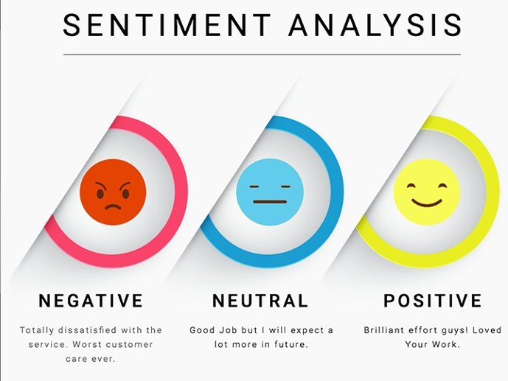

Slide 3
Problem statements/ application
Social media monitoring
Customer support
Customer feedback
Product analysis
Market research and competitive research
Brand monitoring and reputation management
Voice of customer (VoC)
Voice of employee

Slide 4


Slide 5
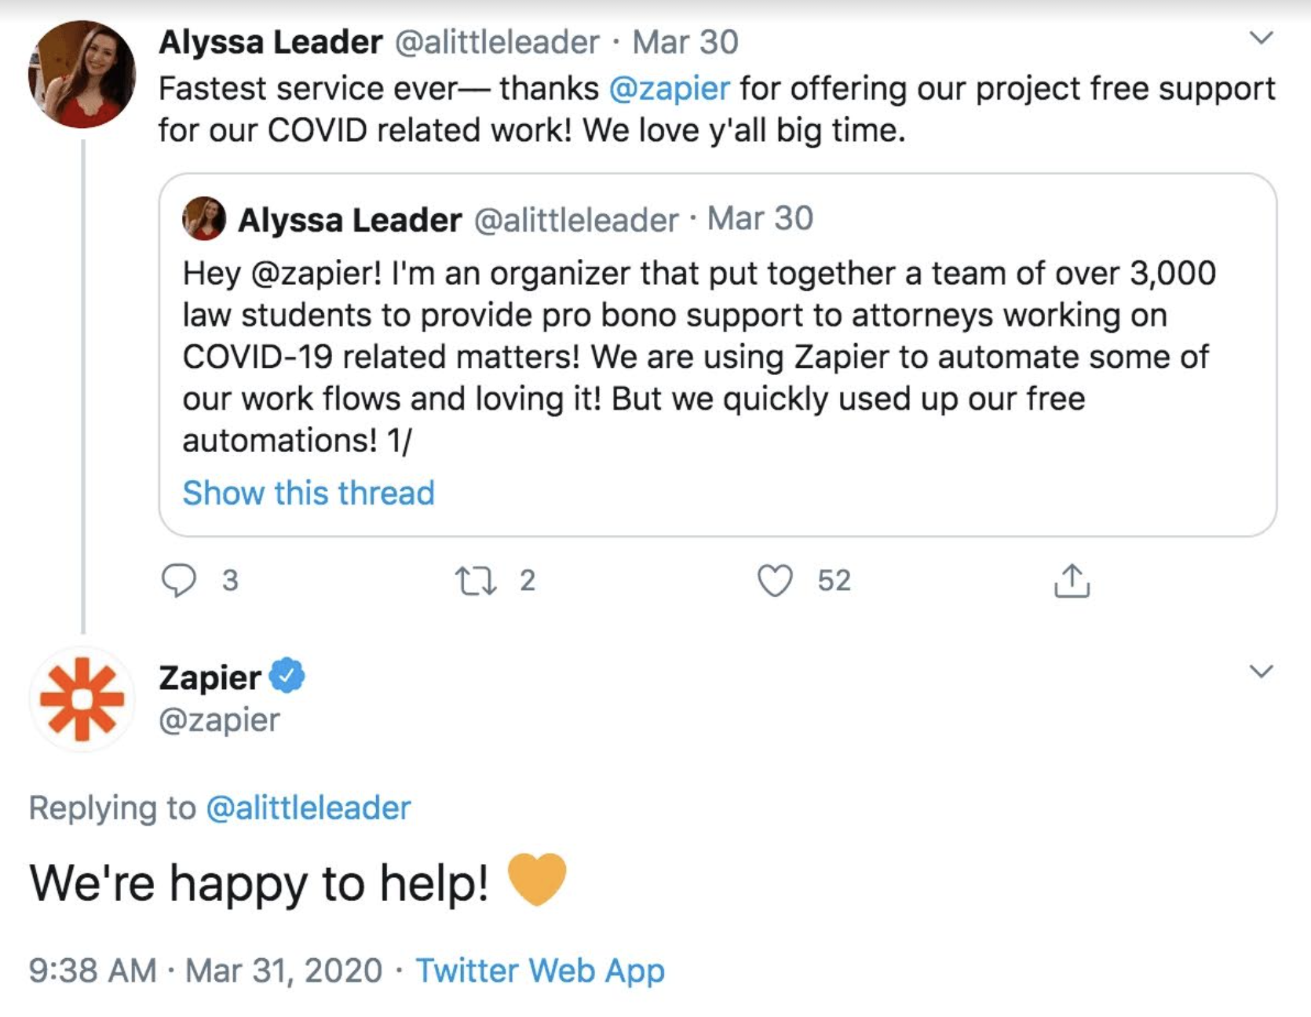

Slide 6
DataSet
Tweepy - Real time data using Twitter API to fetch the tweets about a particular query. ( Here, Christmas related)
We are generating a dataset which contain 1000 rows and 11 columns.
The data also contain many special symbols and different emoji - handled during preprocessing.
TextBlob we get the polarity of each tweet like Greater than 0 being a positive sentiment, equal to 0 being a neutral sentiment and less than 0 being a negative sentiment.

Slide 7
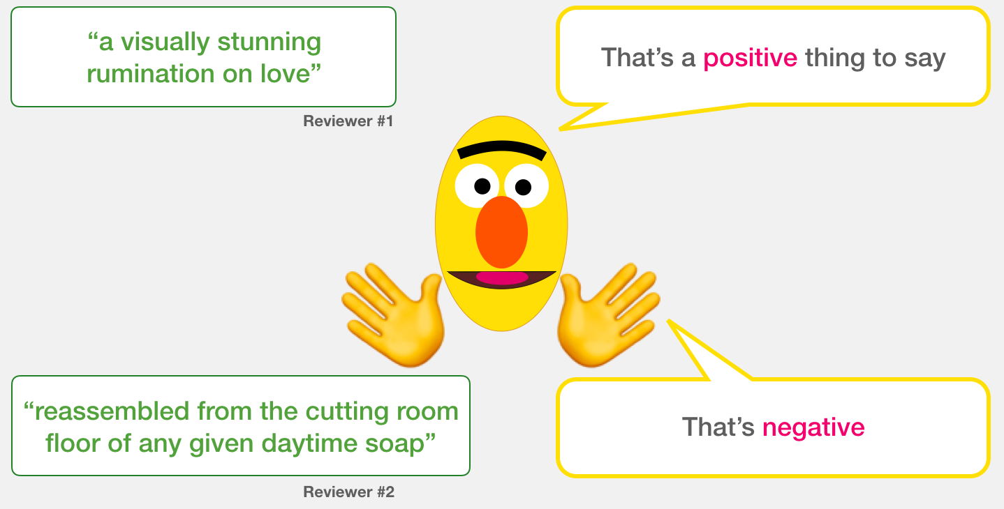

Slide 8
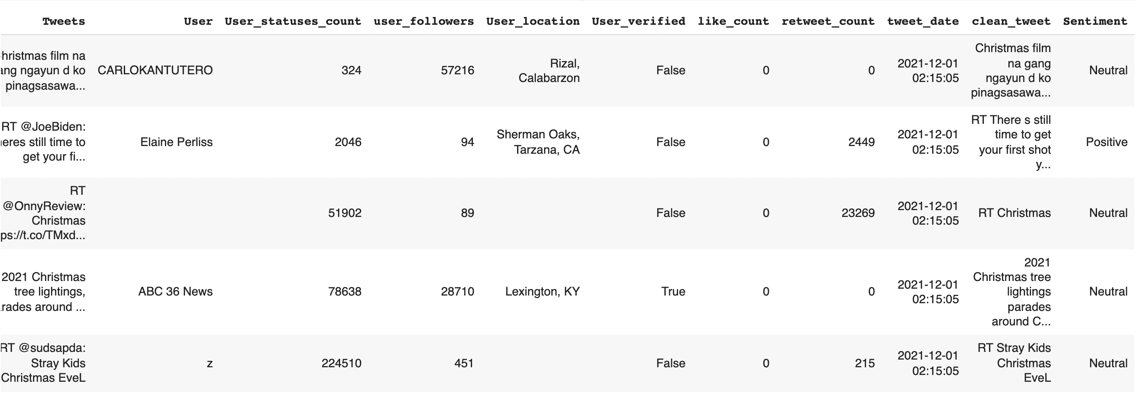
Dataset

Slide 9
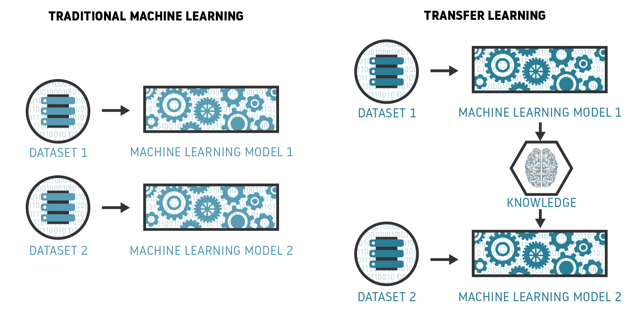

Slide 10
Transfer Learning
Transfer learning is a technique where a deep learning model trained on a large dataset is used to perform similar tasks on another dataset.
We call such a deep learning model a pre-trained model.
Most of the tasks in NLP such as text classification, language modeling, machine translation, etc. are sequence modeling tasks.
Most of the tasks in NLP such as sentiment analysis, text classification, language modeling, machine translation, etc. are sequence modeling tasks.
But traditional RNN or LSTM takes one token at a time hence a long time for training making it an inefficient choice.
Thus, the need for transfer learning in NLP in omnipresent.

Slide 11
DistilBERT
This pre-trained model is a type of Transformer model and is fast and small when compared to the original BERT model.
It was reduced by 40% from the original BERT model which was created by google.
This model runs 60% faster, and it also preserves 95% of the performance of BERT model.
This variation of BERT is particularly useful when a large model is trained with huge networks, its full output distribution can approximated from the smaller network

Slide 12
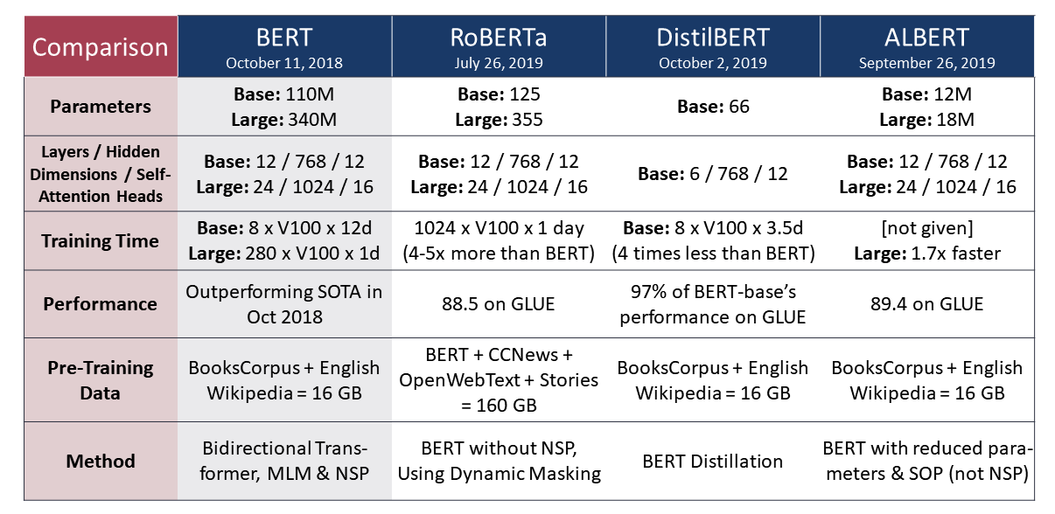

Slide 13
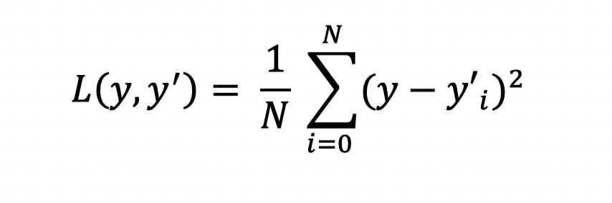
Loss function
The Loss Function used in this paper is mean squared error which is usually used for regression problems. This loss function is very much sensitive towards outliers

Slide 14
Results
The model obtained a result of 82.14% accuracy
20 epochs
During training the learning rate was set 0.01

Slide 15
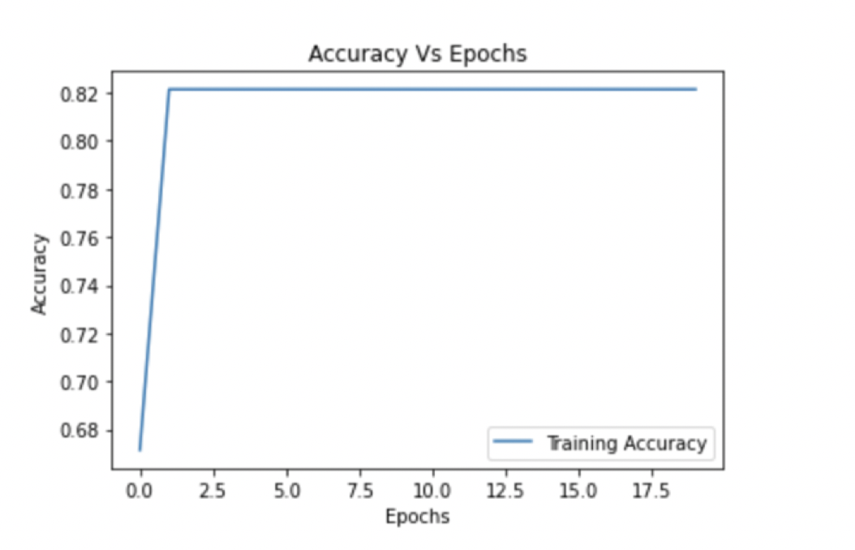
Graph of Accuracy vs Epochs
We can see that after few epochs the accuracy is constant.

Slide 16
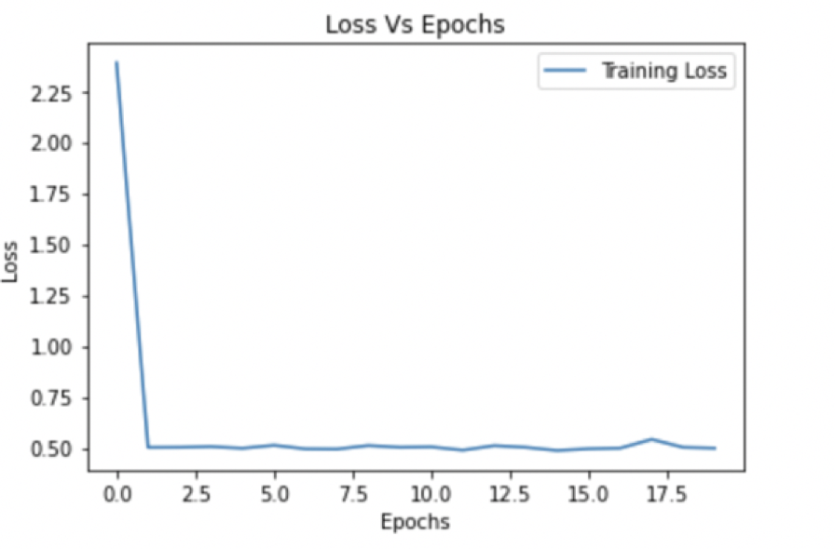
Graph of Loss vs Epochs
The loss is not constant there is a slight variation in the loss

Slide 17
Conclusion
Different Transformer Based Architectures Used in Sentiment Analysis
Concentrate on what causes sentiment changes on Social Media
Make use of other variations of BERT, ELMo Variations, Open AI GPT Series and add detailed classification of text to address more complex problems related to Sentiment Analysis using NLP

Slide 18
REFERENCES
[1] Twitter Sentiment Analysis Based on Ordinal Regression Shihab Elbagir and Jing Yang
[2] Detecting Topic and Sentiment Dynamics Due to COVID-19 Pandemic Using Social Media Hui Yin, Shuiqiao Yang , and Jianxin Li
[3] New Clustering Algorithms for Twitter Sentiment Analysis Hajar Rehioui and Abdellah Idrissi
[4] Sentiment Analysis of News Headlines Using Simple Transformers

